Slide 1
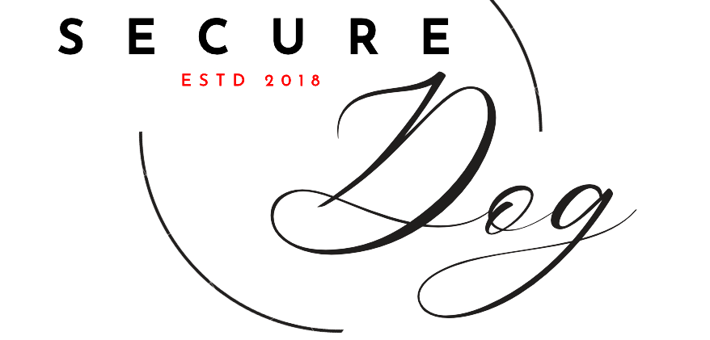

Slide 2
About Secure Dog
Owners with military training & business administration backgrounds
Our mission: Seeking to promote peace of mind and facilitate safe environments by enhancing dogs sharp sense and natural protective instincts. All while giving our animals a sense of purpose.

Slide 3
About our Services
Military grade protection
Fully trained guard dogs
Transportation provided
Dogs fully insured by Secure Dog

Slide 4
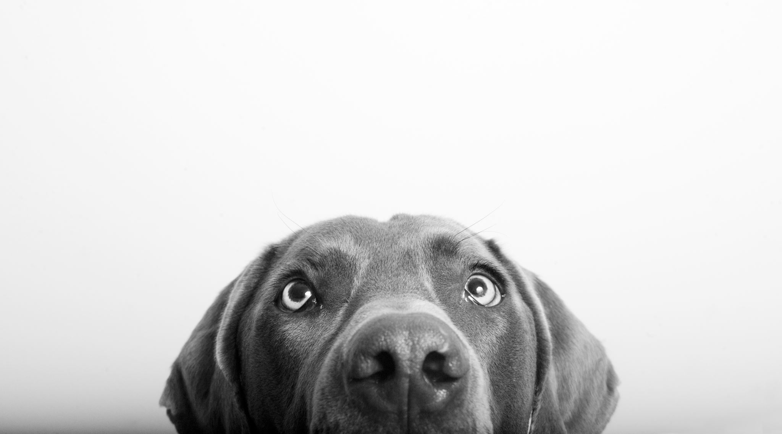
Features
Dogs are selected for their natural courage, strength, and bulk/size
Dogs trained in proper aggressiveness, territorial sense, and resistance to counterattack
All dogs provided with high tech collar

Slide 6
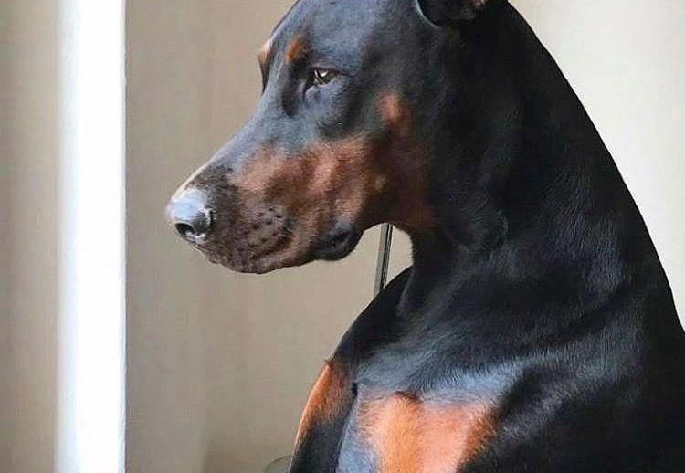
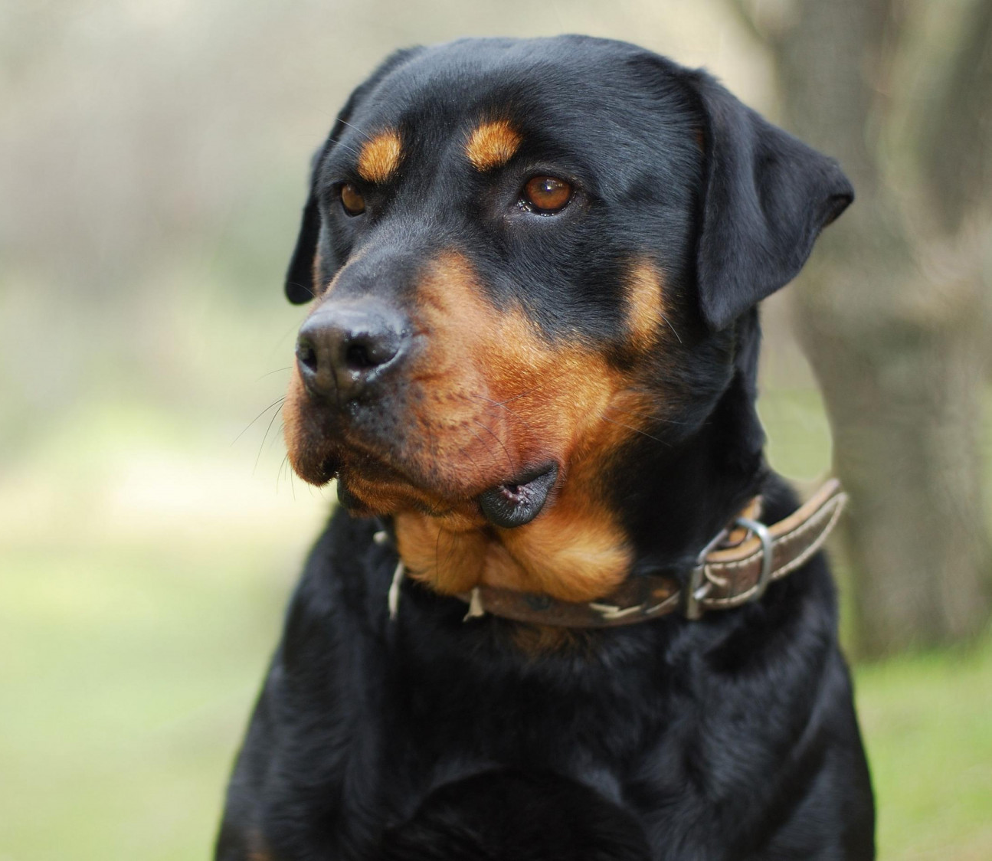
Dog Breeds
(With nightly prices)
German Shepard ….$20
Pitbull ….$18
Doberman Pinscher ….$19
Chihuahua ….$10
Rottweiler ….$20

Slide 7
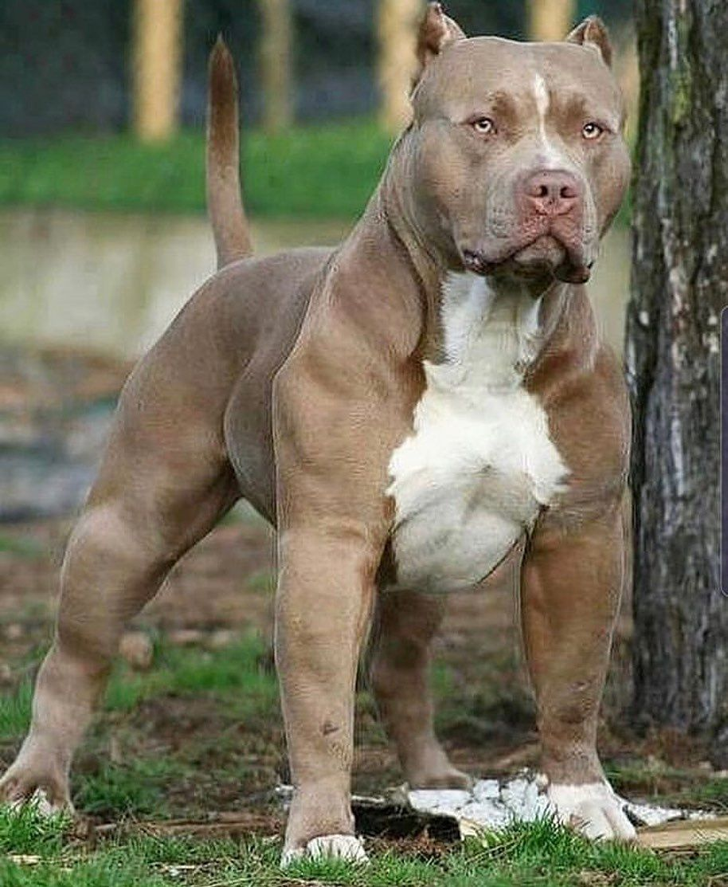
Razor

Slide 8
Average Savings = 20%
With a $40,000 insurance premium
$8,000 can be saved annually

Slide 9
Testimonials
“I was unsure about having an animal as security because its unconventional, but not only have we had no break ins, but we've saved over 23% on our insurance premium since getting our guard dog!” – Mary, LX Manufacturing
“Secure Dog saved my company, we were about to lose our insurance due to the high frequency of break ins we experienced, but since we got Max, our German Shepard, our property has been safer than ever.” – Andrew, American Supply

Slide 10
Questions ?

Slide 11
Research shows break-ins are 72% less likely when an animal is present

